Slide 1

Neural Networks and Deep Learning
Eli Gutin
MIT 15.S60
(adapted from 2016 course by Iain Dunning)

Slide 2
Goals today
Go over basics of neural nets
Introduce TensorFlow
Introduce Deep Learning
Look at key applications
Practice coding in Python
Become familiar with Deep Reinforcement Learning (if time permits!)

Slide 3
Plan for today
Theory: Supervised learning & NNs Coding: classification problem
Theory: Unsupervised learning Coding: auto-encoder
Theory: Deep Learning
Coding: MNIST with ConvNets
Theory: Deep Reinforcement Learning

Slide 4
Supervised Learning and Neural Nets

Slide 5
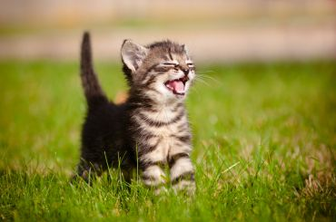
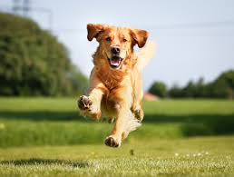
Motivation
Artificial intelligence…
Basic example: can the computer distinguish between cats and dogs?

Slide 6
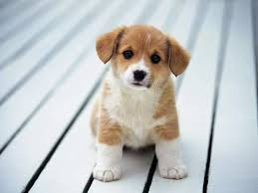
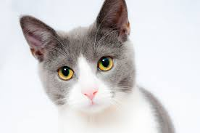
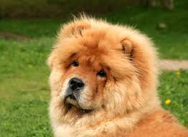
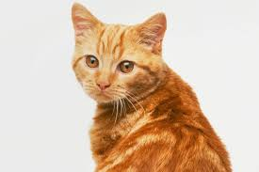
Supervised Learning
Dog=1
Cat=0
Cat=0
Dog=1
Dog=1
Now tell me: cat or dog?

Slide 7
Supervised Learning
Each image is 32x32=1024 pixels
3 channels: RGB
Input is a 1024*3 = 3072 dimensional space

Slide 8
Supervised Learning
Each image is 32x32=1024 pixels
3 channels: RGB
Input is a 1024*3 = 3072 dimensional space
Ground truth function if dog; else 0
Given training samples can we find ?

Slide 9
Perceptron: an early attempt
Activation function

Slide 10
Perceptron: an early attempt
Activation function
Need to tune and
x1
w1
…
w2
x2
σ
b
1

Slide 11
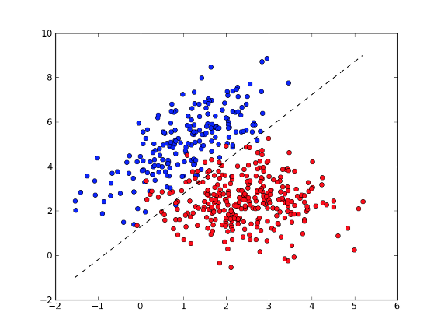
Perceptron: an early attempt

Slide 12
Perceptron: an early attempt
“Tune w and b
so that the approximation is accurate”

Slide 13
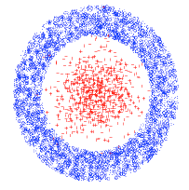
Main issue with Perceptron
Ground truth may simply not be linear
Need to generalize the Perceptron idea

Slide 14
Multilayer perceptron
1
w_{1A}
w_{1B}
2
A
w_{1C}
3
A neuron is of the form 1(w.x + b > 0)
We can call the box a “neuron”

Slide 15
Multilayer perceptron
w_{1A}
A
1
w_{AE}
w_{2B}
B
2
E
C
3
w_{DE}
w_{1D}
D
A neuron is of the form 1(w.x + b > 0)
We just added a neuron layer!

Slide 16
Multilayer perceptron
w_{1A}
A
1
w_{AE}
w_{2B}
B
2
E
C
3
w_{DE}
w_{1D}
D
A neuron is of the form σ(w.x + b) where σ is an activation function
We just added a neuron layer!
We just introduced non-linearity!

Slide 17
Ways to choose activation function
STEP FUNCTION
Used in good old-fashioned perceptron

Slide 18
Ways to choose activation function
LINEAR
like linear regression
(only used for final layer)
LOGISTIC / SIGMOIDAL / TANH
Smooth, differentiable, saturating functions
RECTIFIED LINEAR (ReLU)
Cheap to compute, popular lately

Slide 19
Final generalization for MLP
Output can be multi-dimensional

Slide 20
Universal approximation theorem
Theorem: 2-layer NNs with sigmoid activation functions can approximate any other function
(Kurt Hornik: Approximation Capabilities of MultiLayer FeedForward Networks, 1991)

Slide 21
How do we optimize the neural net’s parameters?
Quantify how bad the current net is via loss function

Slide 22
How do we optimize the neural net’s parameters?
Quantify how bad the current net is via loss function
Training data is . Parameters
Loss function is
E.g. square loss

Slide 23
How do we optimize the neural net’s parameters?
Quantify how bad the current net is via loss function
Training data is . Parameters
Loss function is
E.g. square loss
Need to minimize the loss function

Slide 24
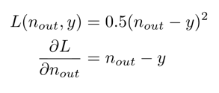
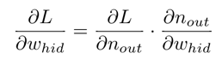
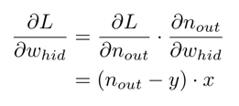
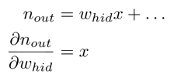
Backpropagation algorithm
f
f
f
w_{inp}
n_{hid}
w_{hid}
n_{out}
Chain rule!

Slide 25
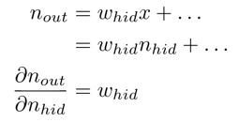
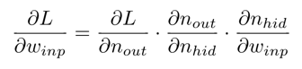
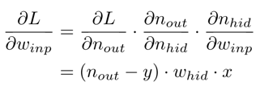
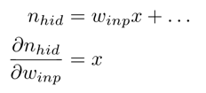
Backpropagation algorithm
f
f
f
w_{inp}
n_{hid}
w_{hid}
n_{out}

Slide 26
Notes on backpropagation
Can calculate derivatives automatically
Opportunities for parallelism
Re-using intermediate values and other efficiencies
Painful DIY - if only there was a framework...

Slide 27
Implementing Neural Nets with TensorFlow

Slide 28




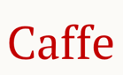
Frameworks for Implementing Neural Networks

Slide 29
Today: Google TensorFlow
Use TF to describe computations as a graph
TF schedules computations on devices - CPU, GPU...
Performs automatic differentiation (like JuMP!)
Python is easy to use

Slide 30
Project 1 - Nonlinear classification
Goal: approximate an unknown non-linear classifier from data
Plan: generate data, create ANN, fit it
Live coding in IPython - follow along!
Play with extending the code

Slide 31
Project 1: Non-linear classification
f
f
Y
f
f
N
f
INPUT
HIDDEN LAYER
SOFTMAX OUTPUT LAYER
OUTPUT

Slide 32
Project 1: softmax layer
Generalization of logistic function
Squashes a bunch of arbitrarily real numbers into a prob. distribution
Think of this as yet another activation function

Slide 33
Project 1: cross-entropy loss
Since we’re comparing a prob. distribution to true 1-hot encoding, we’ll use the cross-entropy function as the loss:

Slide 34
Project 1: extensions
Try changing…
the number of training points
the number of hidden neurons
the input layer activation function
Gradient Descent’s learning rate
the optimization algorithm
etc.

Slide 35
Unsupervised learning & data representation
http://www.mit.edu/~9.520/fall16/Classes/ldr.html

Slide 36
Successful ML ingredients
Learning algorithms
Lots of labeled data
Computational power

Slide 37
Successful ML ingredients
Learning algorithms
Lots of labeled(!!) data
Computational power

Slide 38
Why unsupervised?
Labeled data is expensive to get
Unlabeled data cheaper / widely available
Different goals:
Cluster analysis
Embedding data in new vector spaces
Compression…
Finding good representations can improve Supervised Learning

Slide 39
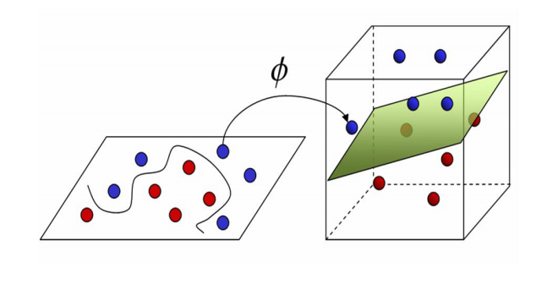
Why unsupervised?
Finding good representations can improve Supervised Learning

Slide 40
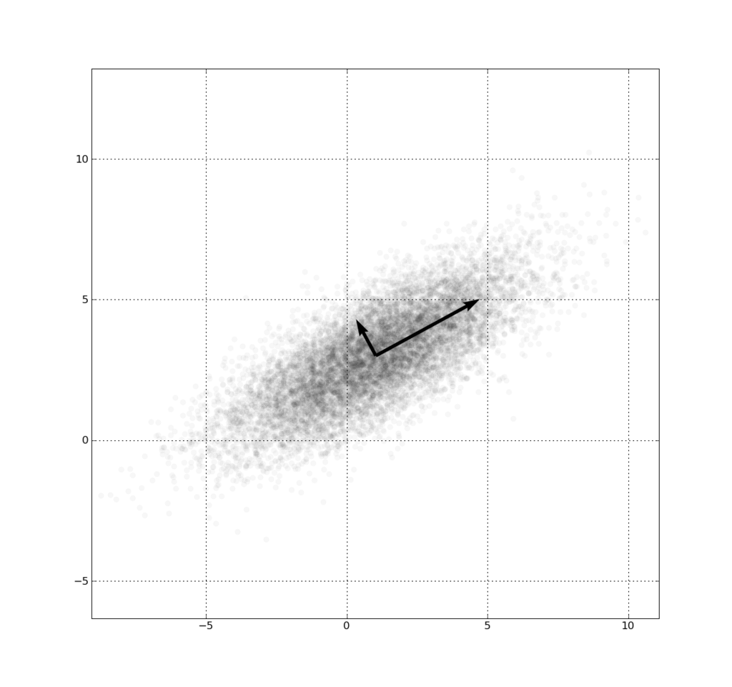
Example: autoencoders
Images are high-dimensional vectors
Hypothesis: can project high-dimensional vectors into low-dimension without much loss
PCA is a classic way of doing this
Can also use ANN!

Slide 41
ERROR = f(INPUT - OUTPUT)
ENCODE
DECODE
f
f
f
f
f
f
HIDDEN LAYER
HIDDEN LAYER
OUTPUT
INPUT
CODE

Slide 42
Project 2 – “learn” binary?
Consider “one-hot” vectors for the numbers 1 to 8
[1,0,0,0,0,0,0,0] [0,1,0,0,0,0,0,0] [0,0,1,0,0,0,0,0] …
Can represent these vectors in 3D, e.g.
[0,0,0] [0,0,1] [0,1,0] [0,1,1] [1,0,0] [1,0,1] [1,1,0] [1,1,1]
Can a neural network learn that?
Concept from: https://blog.wtf.sg/2014/05/10/recursive-auto-encoders-an-introduction/

Slide 43
Project 2 – “learn” binary?
1
ENCODER
DECODER
2
3
...
Concept from: https://blog.wtf.sg/2014/05/10/recursive-auto-encoders-an-introduction/

Slide 44
Project 2 - Assignments - Try...
… changing the activation functions
... using fewer hidden units - what can you recover?
... using multiple layers
… using different weight for encoding and decoding or adding biases

Slide 45
Recent work on representations: word2vec
Given a text corpus, embed words in n-dimensional space
“Similar” words should be “close” in this space
Use a (fairly simple) neural network to encode
Results are…
Paper: http://arxiv.org/pdf/1301.3781.pdf
TensorFlow example: https://www.tensorflow.org/versions/master/tutorials/word2vec/index.html

Slide 46
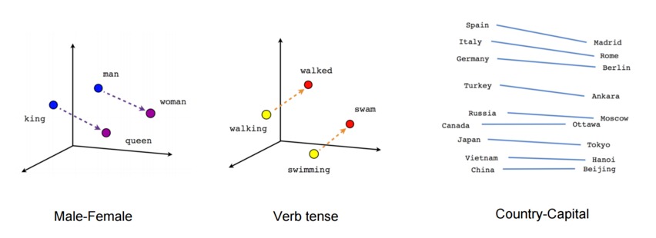
PARIS - FRANCE + ITALY = ROME
JAPAN - SUSHI + GERMANY = BRATWURST
BIG - BIGGER + COLD = COLDER

Slide 47
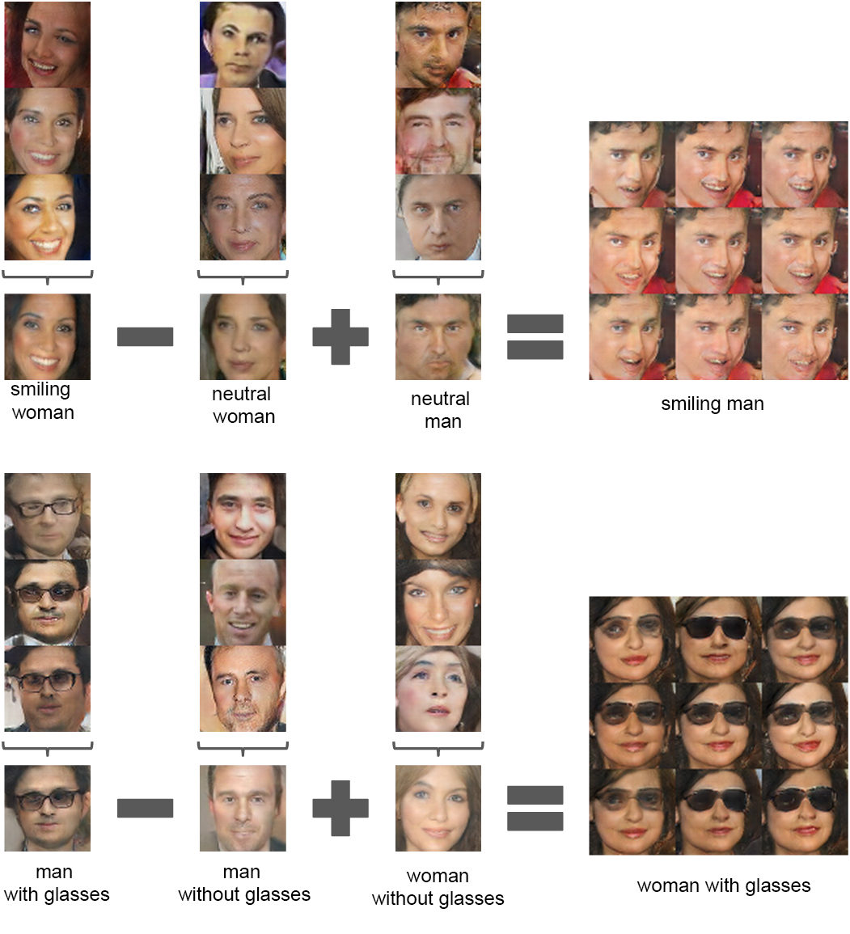
“Unsupervised Representation Learning with Deep Convolutional Generative Adversarial Networks”
https://github.com/Newmu/dcgan_code

Slide 48
Deep Learning with ConvNets
Based on:
https://adeshpande3.github.io/adeshpande3.github.io/A-Beginner's-Guide-To-Understanding-Convolutional-Neural-Networks/

Slide 49
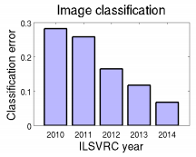
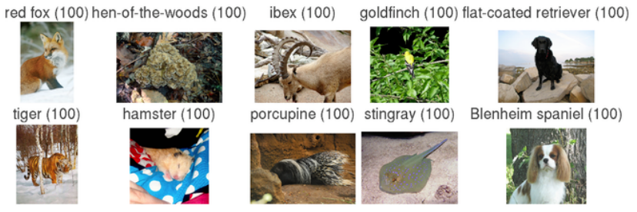
ImageNet Classification Challenge (annual)
More info: http://arxiv.org/abs/1409.0575
1000 object classes, Approximately 1.2 million training, 50k validation, and 100k test images.
Big improvements: 28.2% error rate to 6.7% error rate - human level! How? CNNs!

Slide 50
Deep Learning for image processing
Back to cats and dogs…
Input dimension is ~200k (256*256*3)!!
Challenges:
computationally intensive
questionable performance with shallow architectures…
..would require astronomical amount of data

Slide 51
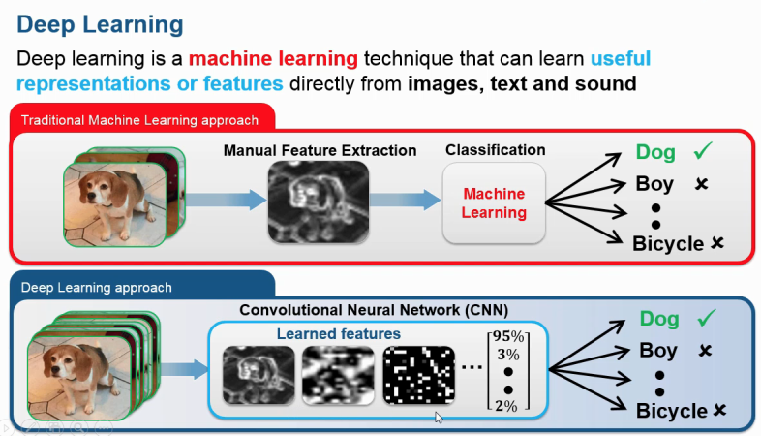
What is deep learning?
Set of algorithms that learn data representation
We focus today on ConvNets
Learning represenation and training classifier at the same time is the novelty with Deep Learning!
“It’s not that SVMs are bad”

Slide 52
Basic ingredients of ConvNets
Lots of layers... more usually perform better!
Most commonly used:
Fully Connected Layers (MLPs - already covered today)
Convolution
Pooling
Dropout
Others: batch norm, ReLU, etc.

Slide 53
Convolution
...
INPUT MATRIX
FILTER
OUTPUT
MATRIX

Slide 54
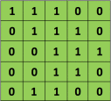
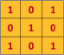
Convolution
Image
Filter

Slide 55

Convolution
Image
Filter

Slide 56
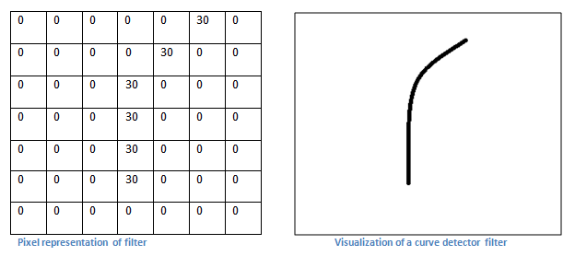
Convolution – The intuition

Slide 57
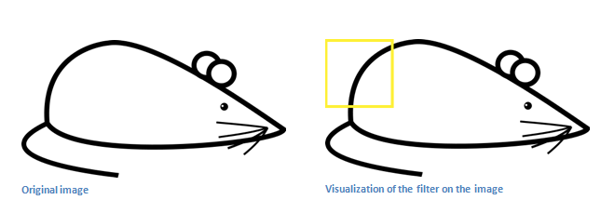
Convolution – the intuition
Recall the curve detector
Output matrix will have a large value here!

Slide 58
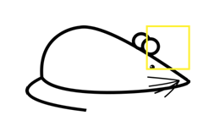
Convolution – the intuition
Conversely, the output matrix will have a
zero value here!

Slide 59
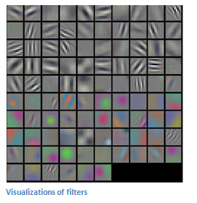
Convolution - summary
Different filters (each acting as a feature detector) produce a feature map
Shallow layers detect low-level features
Deeper layers learn more complicated features

Slide 60
Pooling layers in CNN, deep structures
Maybe a filter learns to detect eyes
Precise location of eye is maybe unimportant
Use a pooling layer to downsample
CONVOLUTION
OUTPUT
2x2 MAX
POOL
POOLING
OUTPUT

Slide 61
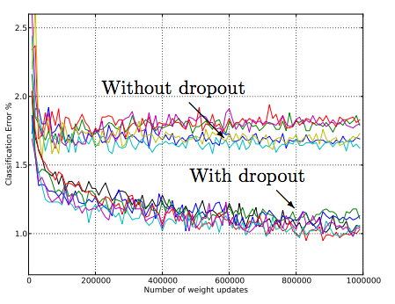
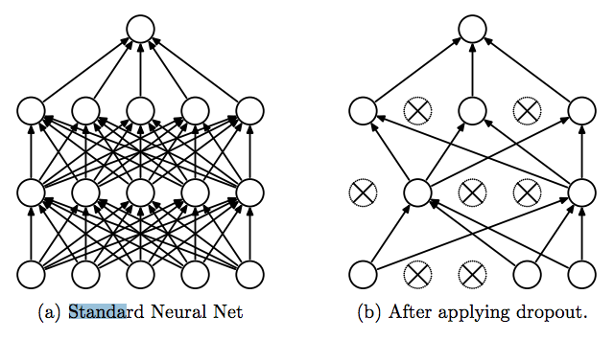
Dropout - cheap regularization for ANN
http://jmlr.org/papers/volume15/srivastava14a/srivastava14a.pdf

Slide 62
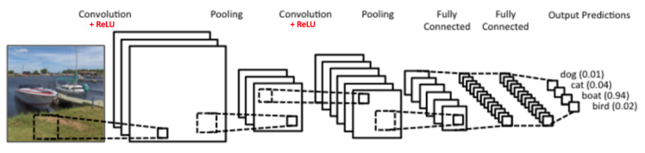
Early ConvNet: “LeNet-5”
http://deeplearning.net/tutorial/lenet.html

Slide 63
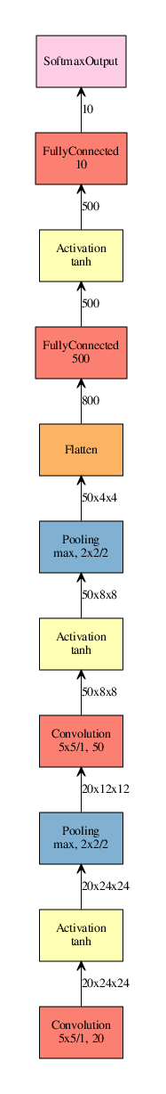
“LeNet”
1998:
“AlexNet”
2012:
“GoogLeNet”
2014:
“Inception v3”
2015:
Source: http://josephpcohen.com/w/visualizing-cnn-architectures-side-by-side-with-mxnet/

Slide 64
Project 3 - MNIST Digit Recognition
Classify hand-written images of digits 0 to 9
Classic “MNIST” data set used widely in ML research
Will use convolutional neural networks!

Slide 65
Project 3 - Assignments - Try...
… changing the filter sizes, max pool size
... adding or removing layers
... using SGD
… varying the amount of dropout (with iteration?)
… varying the batch size

Slide 66
Deep Reinforcement Learning

Slide 67
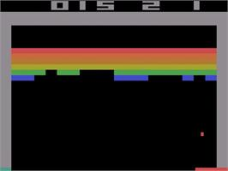
Learning to play from frames?
https://www.youtube.com/watch?v=Q70ulPJW3Gk

Slide 68
Challenges of Reinforcement Learning
Can we learn the right moves from frames/scores?
Need lots of accurately labeled data for ML
However, in video games we have
Sparse noisy signal
Delayed observations
Data is not guaranteed to be independent

Slide 69
Optimal game AI
How do we play (Atari) games optimally?

Slide 70
Optimal game AI
How do we play (Atari) games optimally?
Game is a MDP
State of first t frames

Slide 71
Optimal game AI
How do we play (Atari) games optimally?
Game is a MDP
State of first t frames
Action

Slide 72
Optimal game AI
How do we play (Atari) games optimally?
Game is a MDP
State of first t frames
Action
Discounted return

Slide 73
Optimal game AI
How do we play (Atari) games optimally?
Game is a MDP
State of first t frames
Action
Discounted return
Environment gives state transitions

Slide 74
Q-learning
Q function is the optimal expected return when starting in state s and playing action a

Slide 75
Q-learning
Q function is the optimal expected return when starting in state s and playing action a
Given Q function the optimal policy is straightforward

Slide 76
Q-learning
Model free way to (eventually) get Q
Initialize Q to random values
Initialize state

Slide 77
Q-learning
Model free way to (eventually) get Q
Initialize Q to random values
Initialize state
For i = 1,2,3,4,…:
Play action greedily according to Q function
Environment gives you next state s’
Update with:

Slide 78
Q-learning
Model free way to (eventually) get Q
Initialize Q to random values
Initialize state
For i = 1,2,3,4,…:
Play action greedily according to Q function
Environment gives you next state s’
Update with:
Under certain conditions

Slide 79

Issue with Q-learning
In Atari games the state is last 4 frames
After compression: 84x84 grayscale images with 256 color levels
→ state space of size 256^{84*84*4 ≈} 10⁶⁷⁹⁷⁰!!!
→ we need that much memory…

Slide 80
How to address?
Function approximation
Use ANN!

Slide 81
How to address?
Function approximation
Use ANN!
Given samples of states and actions, find approximation by minimizing:

Slide 82
How to address?
Given samples of states and actions, find approximation by minimizing:

Slide 83
How to address?
Given samples of states and actions, find approximation by minimizing:
The targets are

Slide 84
The DQN algorithm
How to get some independence in the samples?
DQN uses experience replay of last 1M frames
Samples (before, action, reward, after) tuples uniformly from that experience
Then trains the Q-network…

Slide 85
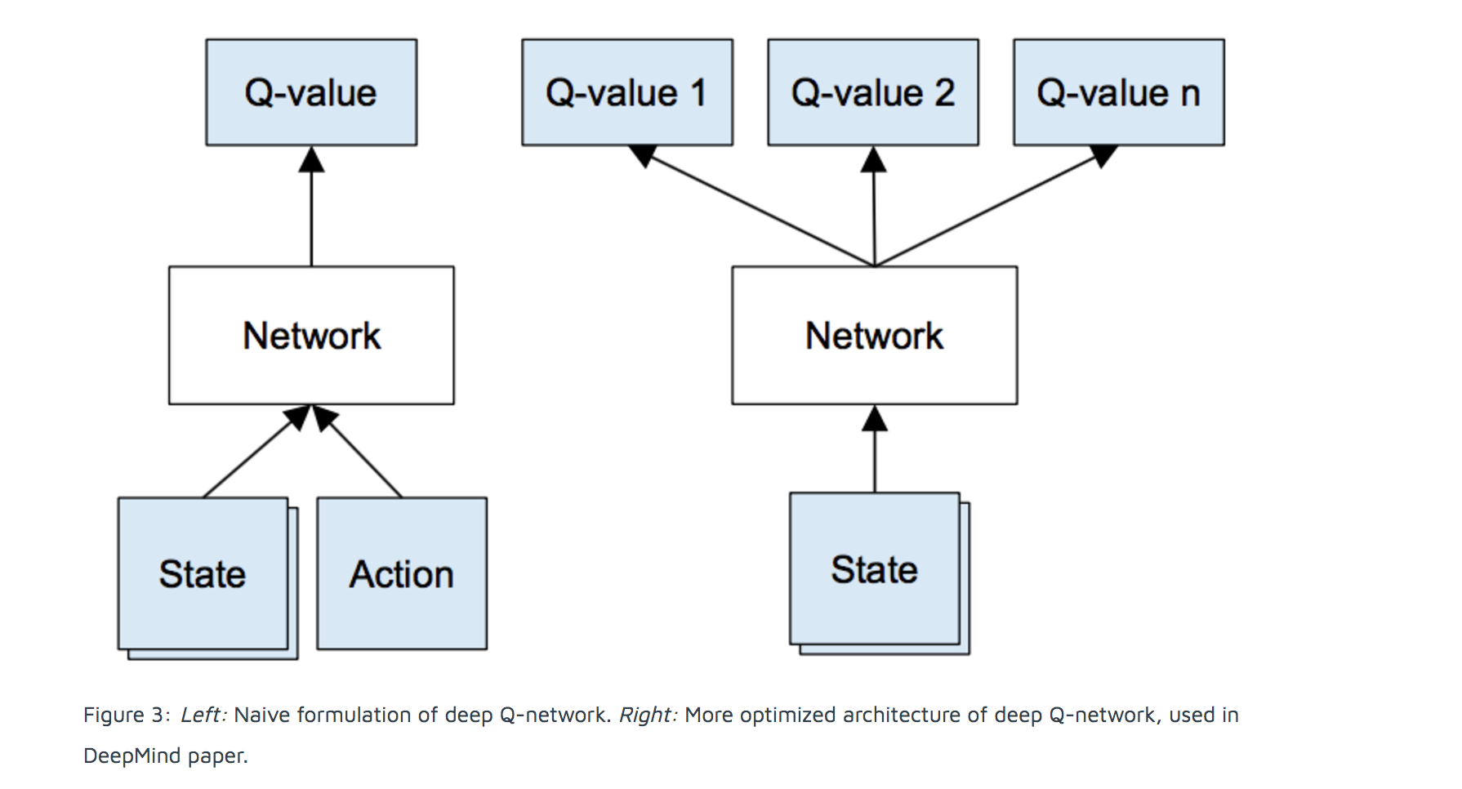
Deep Q-network

Slide 86
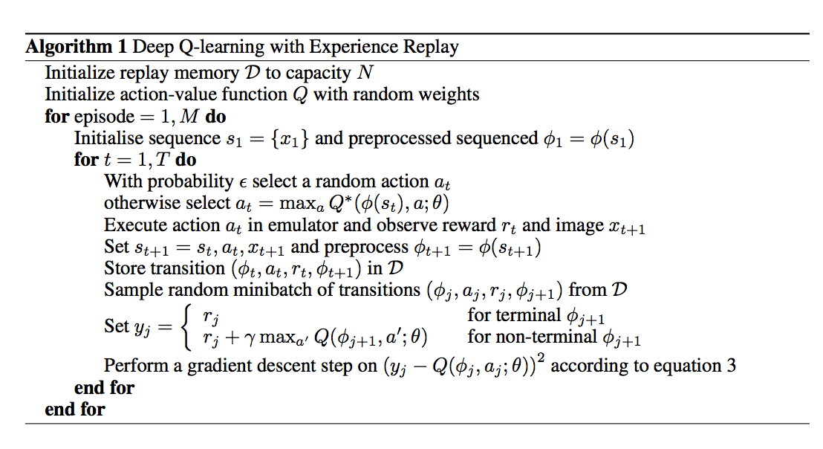
Deep Q-learning
Paper: https://www.cs.toronto.edu/~vmnih/docs/dqn.pdf

Slide 87
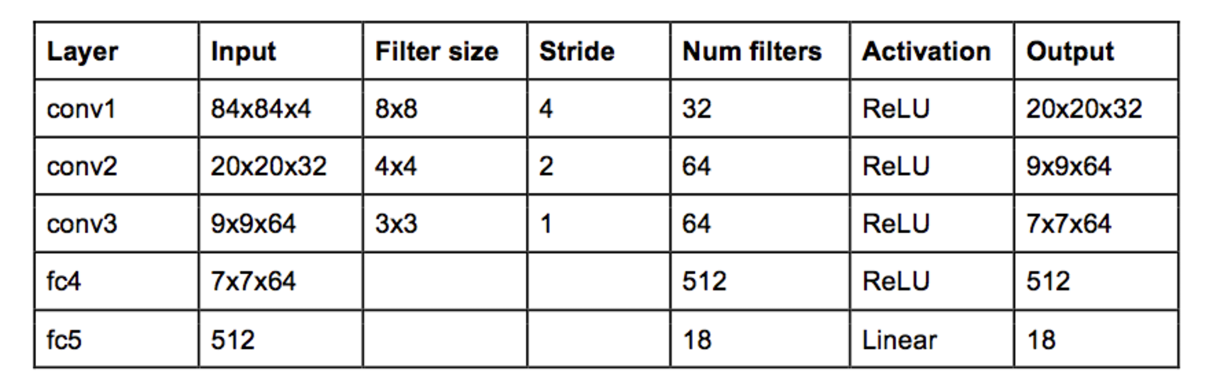
Deep convolution Q network
This is the architecture that DeepMind had in mind

Slide 88
Thank you!

